Slide 1

Health Management Organization
Group 4
Sandra Chiwike | Shachi Desai
Joran Jones | Shoumik Reddy
Prabin Shrestha | Ashish Kulkarni

Slide 2
Index
Objective
Business Overview
Factors affecting cost
Actionable Insights

Slide 3

Business Overview
Healthcare Cost Data
7 Primary locations in the Northeastern region of the USA
14 variables, 7582 rows across:
Demographics
Health Descriptors
Cost as the Primary dependent variable
No time-series data available.

Slide 4
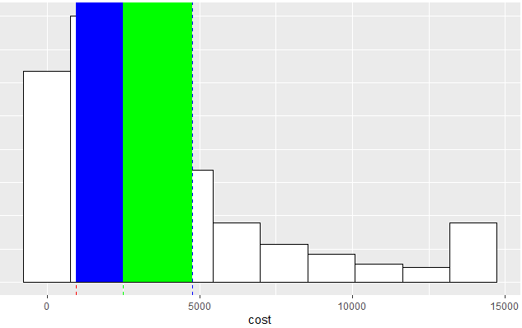
Objective
Predict people spending more money on healthcare next year.
Provide actionable insights to the HMO on how to lower their total healthcare costs

Slide 5
Factors affecting cost Predict people spending more money on healthcare next year.
Age
BMI
Children
Smoker
Exercise
HyperTension

Slide 6
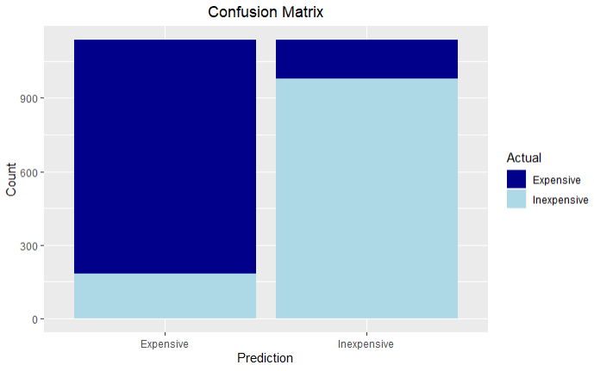
Factors affecting cost Predict people spending more money on healthcare next year.
Based on SVM Model with 85% accuracy

Slide 7
Actionable Insights Key Inferences
10% of the top-paying patients contribute approximately 40% of the overall cost.
40% of the top-paying patients contribute to approximately 80% of the overall cost.

Slide 8
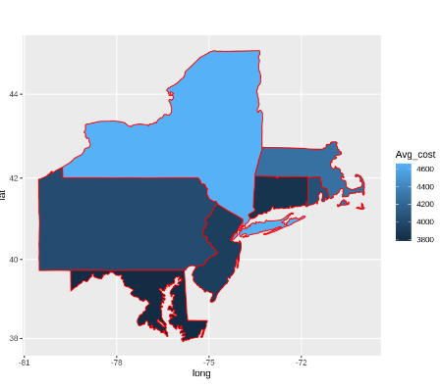
Actionable Insights Short-term
Target audience:
Obese and Old Adults
Obese Adults
Provide add-on external organization services to reduce cost deductibles.
Focus on areas with High Average costs to offer these collaborative health services.
Includes:
Dietician
Wellness Groups/Support Groups
Exercise Mentors/ Trainers

Slide 9
Actionable Insights Long-term
Target audience:
Smoker Young Adult
No Exercise Young Adult
Low Yearly Physical and Adult
Offer cost deductible on “Healthy Program” enrollment
Target locations remain high cost areas
Includes:
Partner Gyms
Partner Counselors
Partner Rehab Centers

Slide 10

Questions

